Slide 1
Exploring the Limits of Transfer Learning with a Unified Text-to-Text Transformer
Colin Raffel, Noam Shazeer, Adam Roberts, Katherine Lee, Sharan Narang, Michael Matena, Yanqi Zhou, Wei Li, Peter J. Liu
Presentation by: Rafael Ferreira
Date: 14/05/2020

Slide 2
Content
T5 – Text-to-Text Transfer Transformer
The Transformer
T5 Applications
Tasks and Datasets
T5 Model - Baseline
Architectures
Unsupervised Objectives
Pre-training Datasets
Training strategies
Scaling
Conclusion
Research Opportunities

Slide 3
T5 – Text-to-Text Transfer Transformer
Text-To-Text – Relates to the input and output formats of the model.
The model receives input to utilize as context to then produce an output.
Transfer – Transfer learning. A Transfer learning model is a model that is first pre-trained on large amounts of data (unsupervised) and is then fine-tuned on a task.
Transformer – The architecture of the model.
3

Slide 4
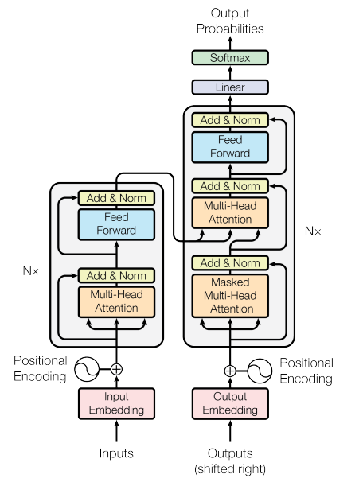
The Transformer
The encoder-decoder version of T5 follows the architecture proposed in Attention is all you need¹.
One of the most important parts of this architecture is the self-attention mechanism. A variant of attention that replaces each element in a sequence by a weighted average of the rest of the sequence.
A tutorial on the attention mechanism and the transformer architecture can be seen here.
4

Slide 5
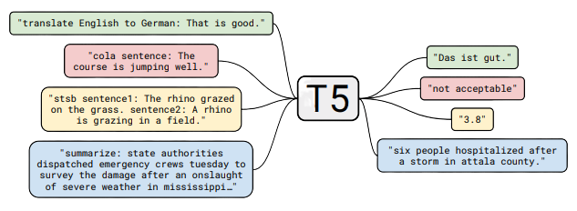
T5 Applications
One of the advantages of a text-to-text format is that it provides a consistent training objective both for pre-training and fine-tuning.
T5 is also able to handle multiple tasks by adding task-specific prefixes to the original input sequence.
Machine Translation
Classification
“Regression”
Question Answering
Summarization
Coreference Resolution

Slide 6
Tasks and Datasets
GLUE¹ and SuperGLUE² – collection of text classification tasks.
CNNDM³ (CNN/Daily Mail) – summarization task.
SQuAD⁴ – extractive question-answering dataset.
EnDe, EnFr and EnRo – translation tasks from English to German (Deutsch), French, and Romanian respectively.

Slide 7
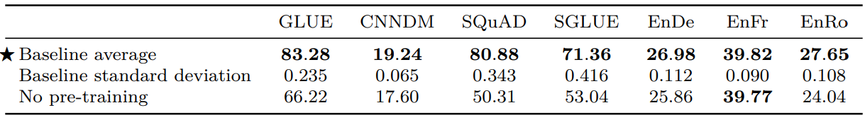
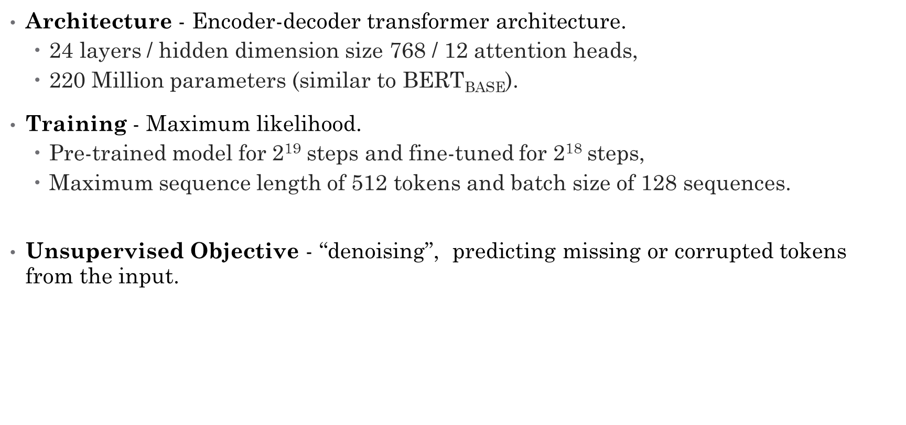
T5 Model - Baseline
Architecture - Encoder-decoder transformer architecture.
24 layers / hidden dimension size 768 / 12 attention heads,
220 Million parameters (similar to BERT_{BASE}).
Training - Maximum likelihood.
Pre-trained model for 2¹⁹ steps and fine-tuned for 2¹⁸ steps,
Maximum sequence length of 512 tokens and batch size of 128 sequences.
The leaning rate schedule is given by $\frac{1}{√max⁡(n,k)}$ where n is the current train iteration and k is the number of warmup steps (constant learning rate of 0.01)
Unsupervised Objective - “denoising”, predicting missing or corrupted tokens from the input.

Slide 8
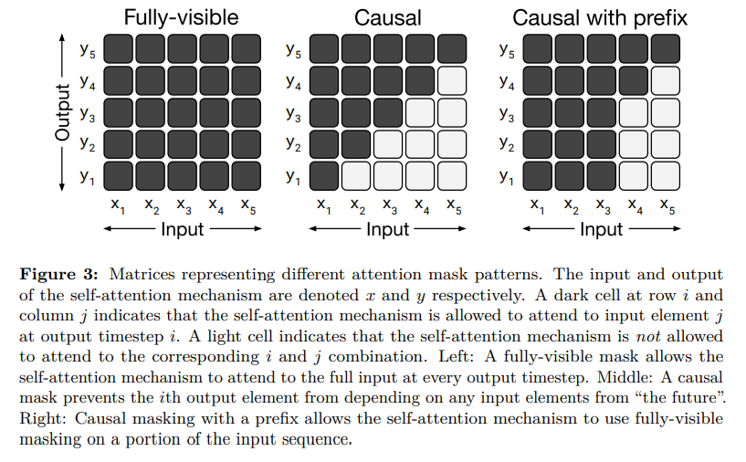
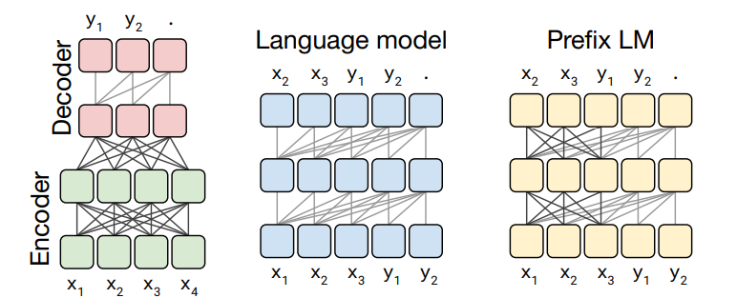
Architectures
Attention Masks
Used to zero out certain weights to attend only to inputs it considers necessary at each step.
Model Structures:
Encoder-decoder:
Encoder uses fully-visible attention mask
Decoder uses causal attention mask
Language model:
Next Step Prediction
Prefix LM
Fully-visible attention mask on prefix
Causal attention mask outside prefix

Slide 9
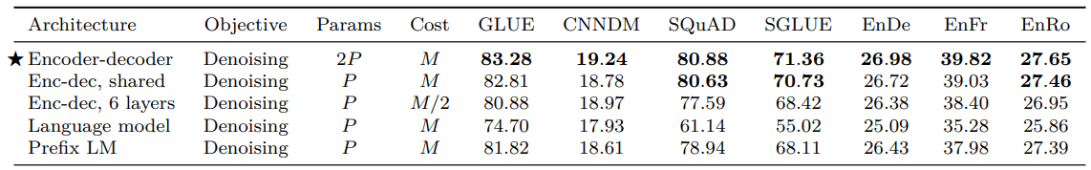
Architectures
Considering the number of layers and parameters as L and P respectively of a BERT_{BASE} model, and M as the number of FLOPs.
Pre-training objectives:
Denoising objective (MLM) – predicting corrupted or missing tokens
Basic language modelling objective

Slide 10
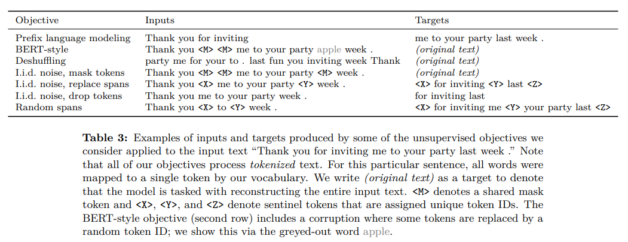
Unsupervised Objectives
Decision of which algorithm to use as the unsupervised objective during pre-training is essential, because it provides the method through which the model “learns the knowledge”.
Examples of unsupervised objectives for the sentence:
“Thank you for inviting me to your party last week.”

Slide 11
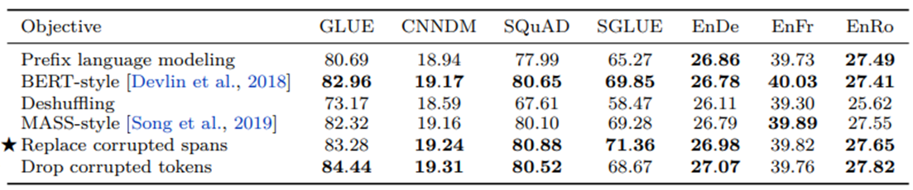
Unsupervised Objectives
Deshuffling objectives perform significantly worse.
Denoising objectives are the best but comparable between themselves.
The major advantage of span corruption comes from their lower computational cost, because on average, span corruption produces shorter sequences.

Slide 12
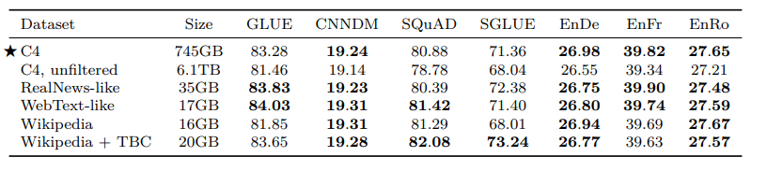
Pre-Training Datasets
The pre-training dataset is another essential part of training, alongside the pre-training objective.
There exists various large-scale unlabeled datasets. More data being produced each month.
Main takeaway is that pre-training on in-domain unlabeled data can improve performance on downstream tasks.
C4
RealNews-like (C4 news)
WebText-Like (C4 Reddit)
Wikipedia
Toronto Book Corpus

Slide 13
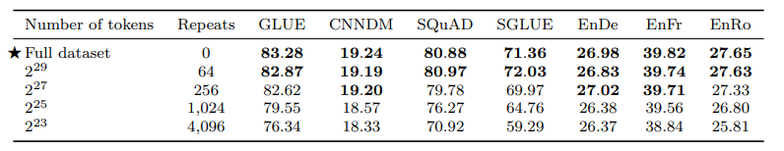
Pre-Training Datasets
Influence of repeating data - Tested using the C4 dataset truncated at different sizes.
Performance generally degrades as the size of the dataset decreases.
When the dataset is repeated 64 times it surpasses the full dataset in some tasks showing that some amount of repetition might not be harmful.

Slide 14
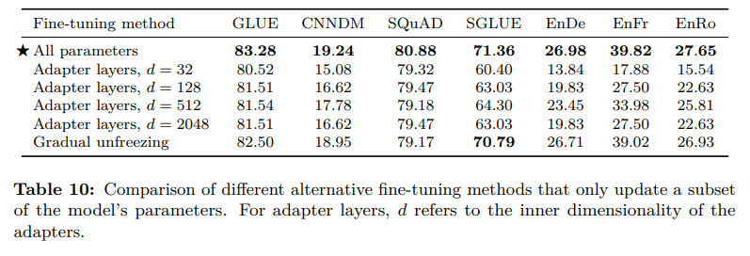
Training strategies
Fine-tuning methods
Adapter Layers¹ – dense ReLU blocks added after each existing FFN in each block of the Transformer. Only the adapter layers and layer normalization parameters are updated. d is the inner dimensionality of the feed-forward network, which changes the number of parameters of the model.
Gradual Unfreezing² – more parameters finetuned over time. The “unfreezing” starts at the top layer.

Slide 15
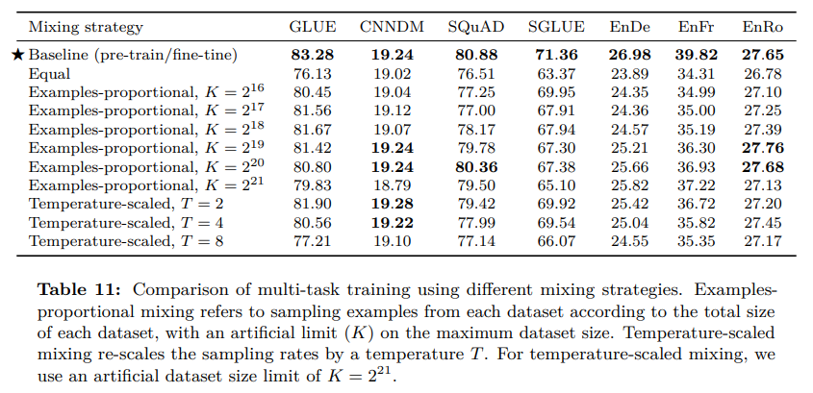
Training strategies
Multi-task learning – train the model at multiple tasks at a time. In T5 this only corresponds to mixing datasets.
Multiple ways of mixing the datasets:
Proportional mixing – proportional to the size of each dataset but using an artificial limit K on the size of each dataset.
Temperature-scaled mixing – using a “temperature” T to control the mixing rate
Equal mixing – equal probability to every dataset (probably not a good idea)

Slide 16
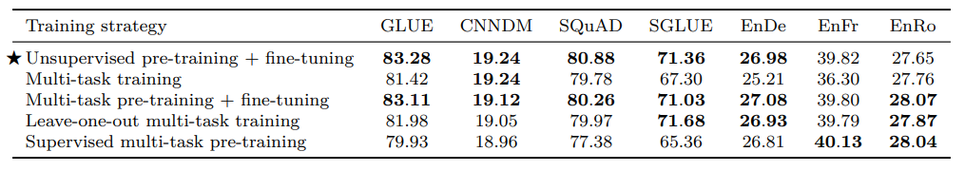
Training strategies
Combining multi-task learning with finetuning – model is pre-trained on all tasks but only fine-tuned on some tasks:
Pre-train the model on the mixture of datasets and fine-tuning it on each task
Pre-train the model on the mixture of datasets and “leave one out” to be fine-tuned on that task.
Pre-training on all datasets
Finetuning after pre-training is comparable to the baseline.
Supervised pre-training performs worse except for the translation tasks

Slide 17
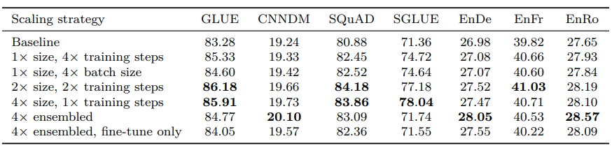
Scaling
Possibility to scale in various ways:
Increasing both model size and training steps improves the results.
Increasing only batch size or training steps are equally beneficial.
Ensembling proves to be a way of improving performance without increasing model size or training time.
Using a larger model
Increasing batch size
Training for more steps
Ensembling (combination of models)

Slide 18
Scaling – Model Size
Model Name | # Parameters | Hidden Size | # Attention Heads | # Total Layers
Small | 60 Million | 512 | 8 | 12
Base | 220 Million | 768 | 12 | 24
Large | 770 Million | 1024 | 16 | 24
3B | 2.8 Billion | 1024 | 32 | 48
11B | 11 Billion | 1024 | 128 | 48
11 B = 11.000.000.000 !!!!

Slide 19
Conclusion
Text-to-text – simple and easily understandable format, that can be adapted to various tasks.
Architectures – the best architecture for a text-to-text format is the encoder-decoder, that although having twice as many parameters as “encoder-only” (BERT) it has a similar computational cost.
Unsupervised objectives – denoising objectives performed better. Changes in the typical algorithm can provide more efficient training.
Datasets – performance degrades when a dataset is repeated many times during pre-training.
Training strategies – updating all weights performed best. But there are methods that can perform similarly in terms of results but faster during training, thanks to only updating part of the parameters.
Scaling – various ways of scaling up to improve performance.

Slide 20
Research Opportunities
Model are very large – invest in ways of reducing the size of the existing models or create new cheaper models.
More efficient knowledge extraction – new pre-training objectives that can leverage the text in a more efficient way, not being necessary to use such a large amount of data.
Measure similarity between pre-training and downstream tasks.
Language Agnostic models – develop models that achieve good performance regardless on the text’s language.

Slide 21
A Simple Coding Example
Following this tutorial, we can use Google’s free TPU’s available in Colab to train a T5 model for QA.
Basic pipeline for using T5:
Use Colab and a Google Cloud Storage Account (300$ free credit)
Install the T5 library
Pre-process the data
Create the necessary datasets (training, validation, test)
Create a task or mixture
Define model
Finetune on the task
Save model
Evaluate
You can also play a trivia question game with the model here.

Slide 22
Thank You!

